Slide 1
Climate Change Impact Analyzer
By: Rachel Armstrong, David Echavarria, and Sahil Tyrewalla

Slide 2
What is our Project
Our project, The Climate Change Impact Analyzer is a Python-based analytical tool designed to:
Accurately preprocess climate datasets from various regions.
Predict key climate parameters (temperature, precipitation).
Identify regional climate patterns through clustering.
Detect anomalies indicating significant climate events.

Slide 3
What is Climate Change
Climate change refers to large, long-term changes in global weather patterns and temperatures. It occurs as rising temperatures, extreme weather occurrences, agricultural problems, and health effects. This can cause food insecurity, loss of homes, and disrupt ecosystems. Addressing this situation requires strong analytical tools that can deliver accurate and useful information.

Slide 4
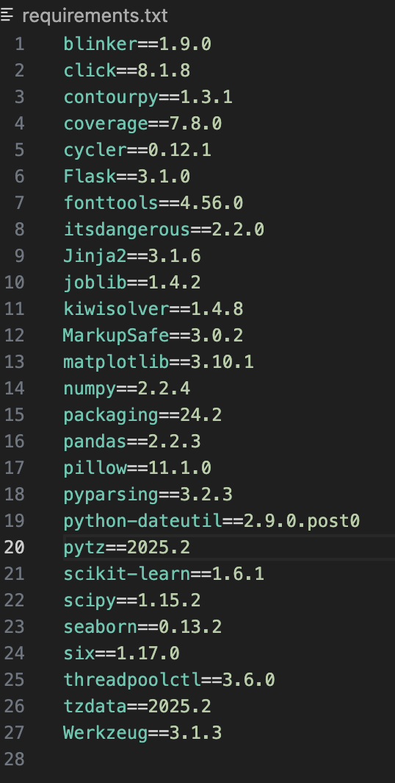
Requirements.txt
Requirements shows packages our project depends on and was generated using pip freeze > requirements.txt
This is our requirements.txt to the right

Slide 5
README
Our README includes:
Description
Setup (how to set code up on your own by creating repository, virtual environment, etc.)
Usage (How to run through main or CLI )
Web Interface (We made an attempt at doing the bonus and includes website link)
Running Test (test effectiveness of our code through unit test and pipeline test for extra credit)
Project Structure
Many Project Features
Much of this will be shown throughout the presentation

Slide 6
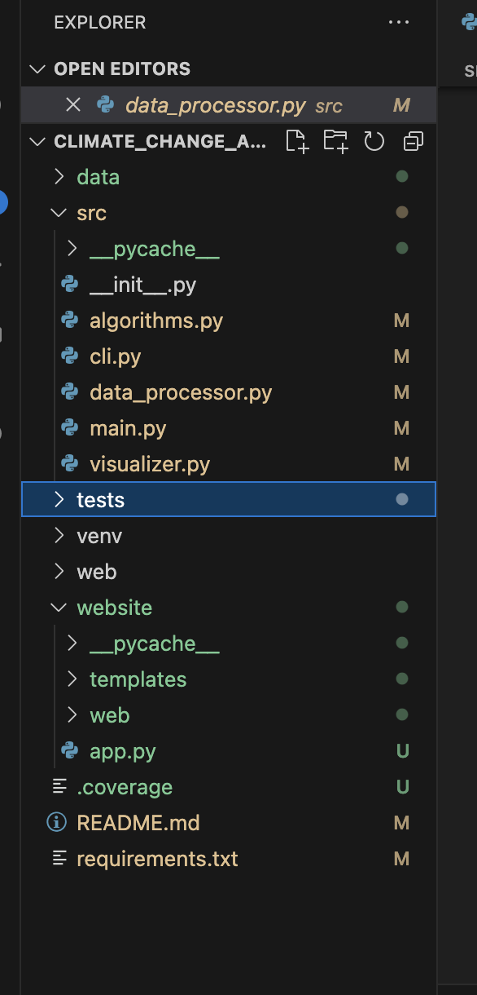
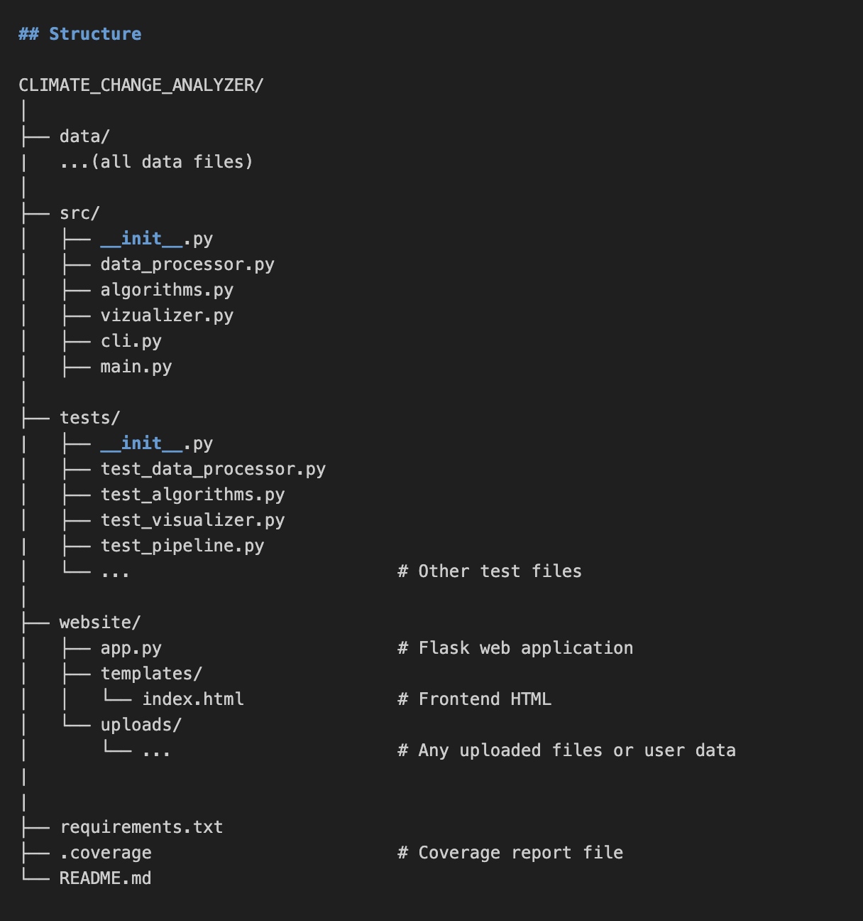
README
As you can see from Project Structure; it stands true to what is shown in photos below

Slide 7
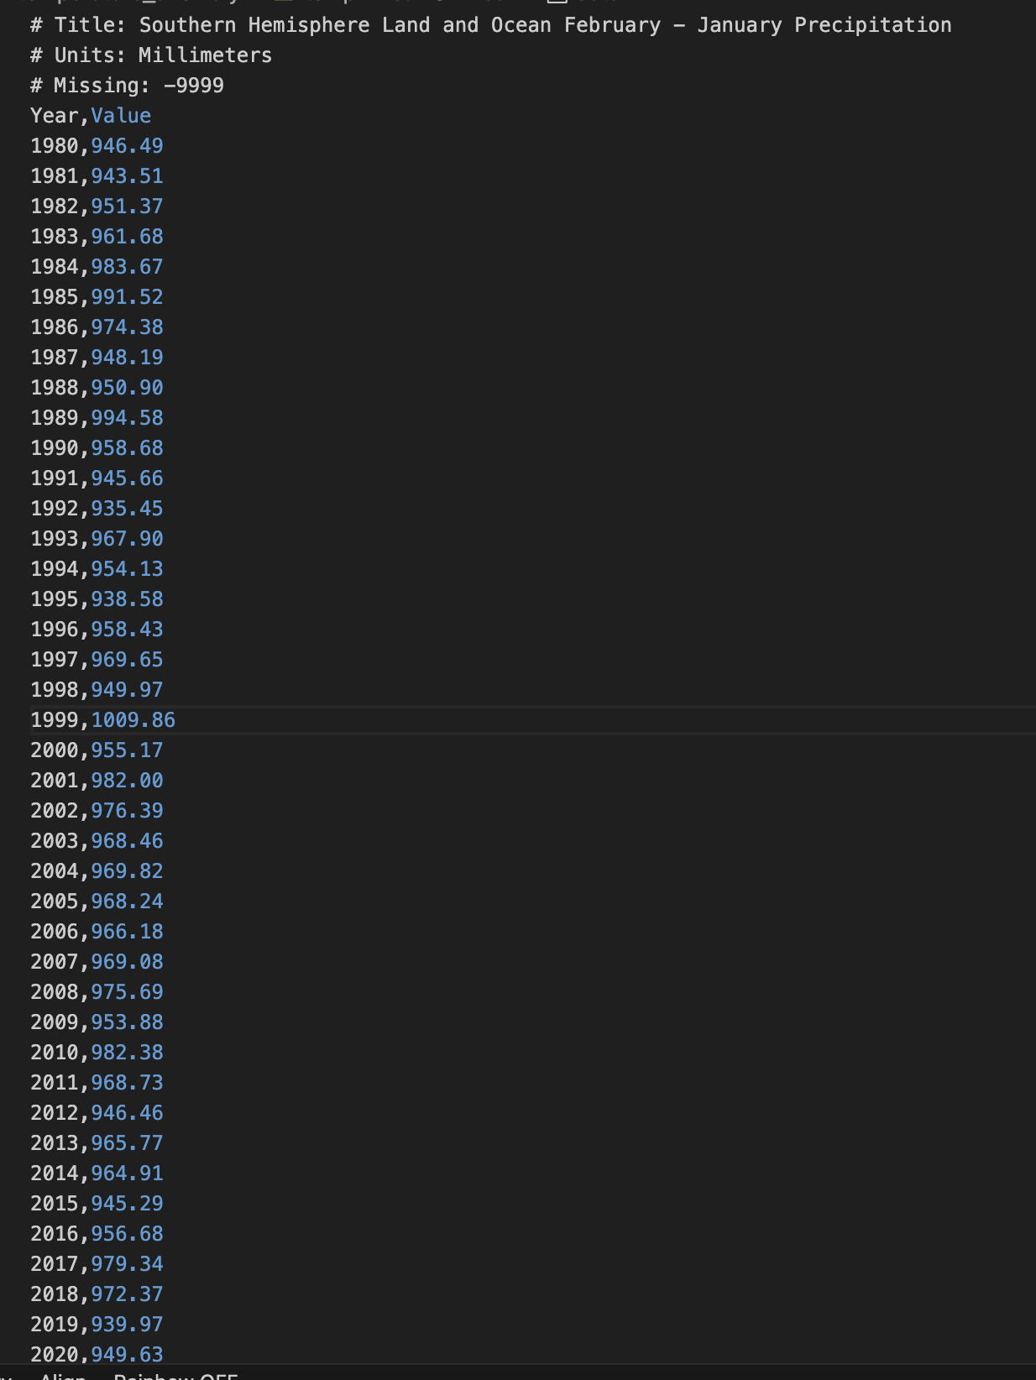
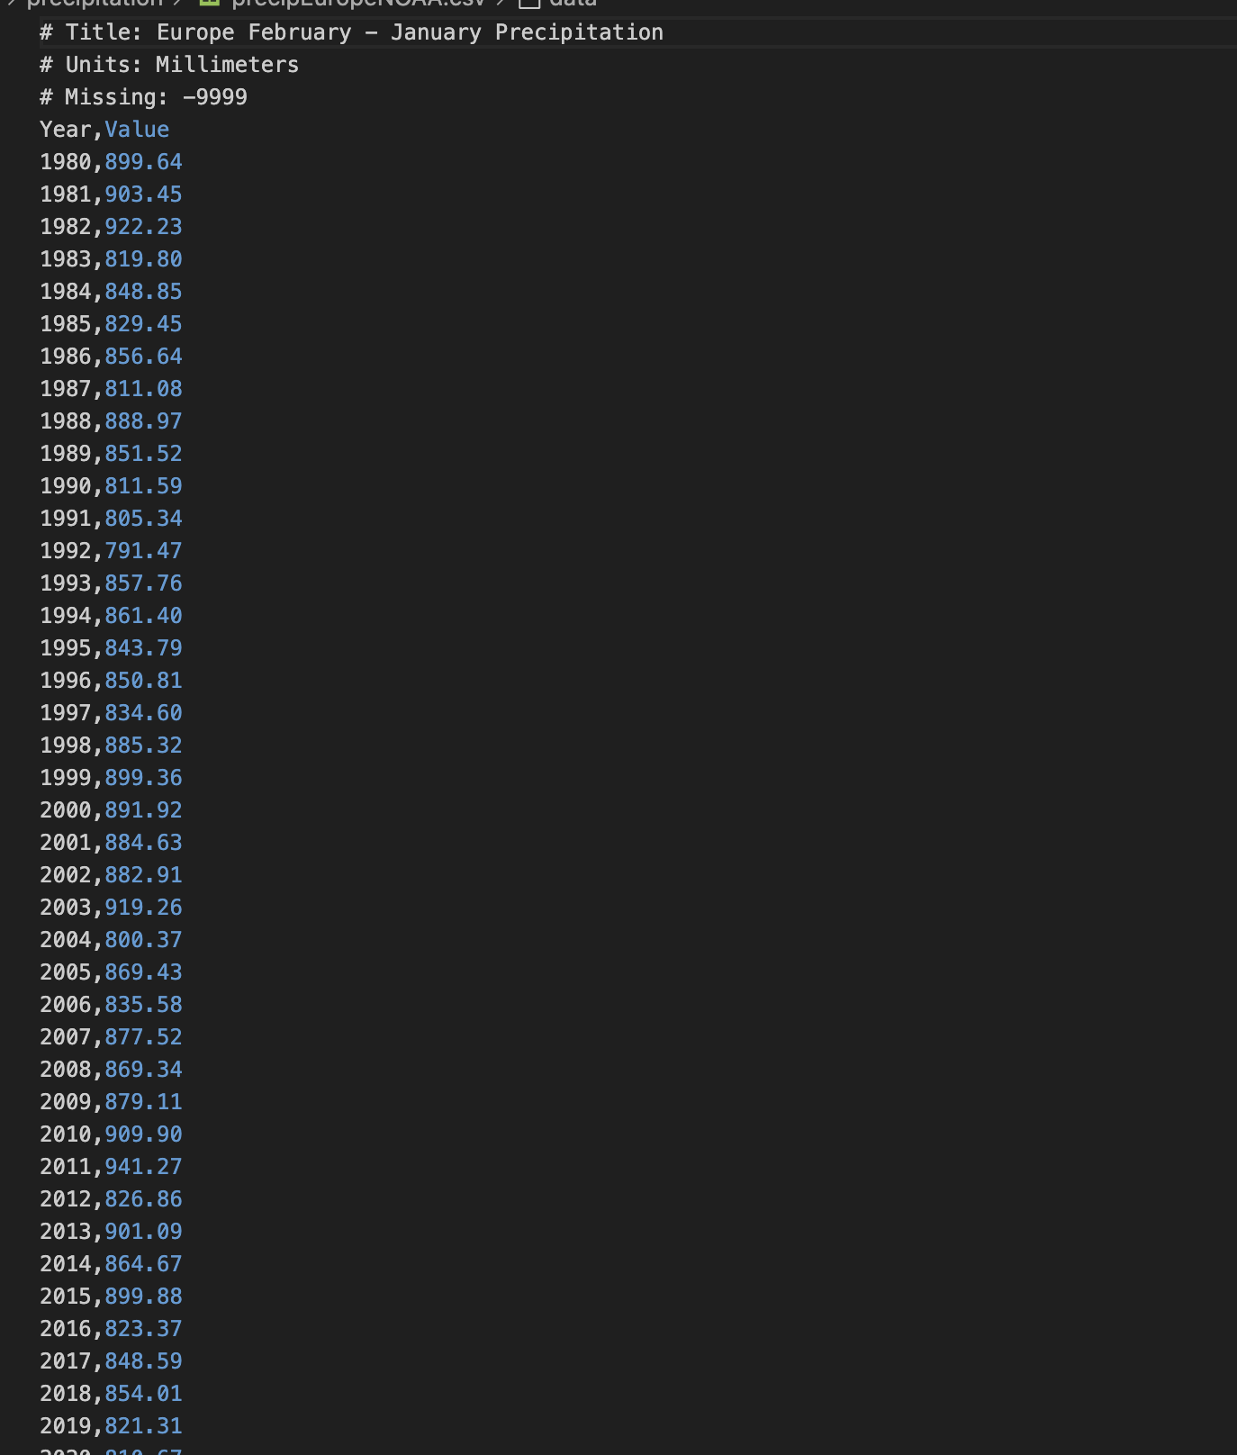
Project’s Data
Collected our data from NOAA and focused on temperature, precipitation and anomalies
Source: NOAA (National Oceanic and Atmospheric Administration) datasets.
Focus: Regional climate data (e.g., precipitation) from 1980 to 2025.
Format: CSV files with Year and Value columns.
Regions analyzed: Caribbean, Oceania, Gulf of America, Northern Hemisphere, etc.

Slide 8
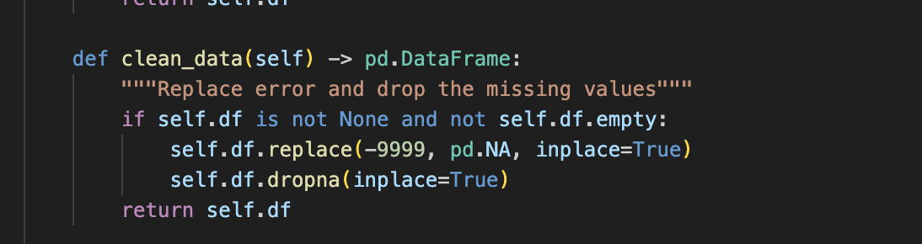
Data Collection and Preprocessing
Data cleaning is the processing of fixing or removing inaccurate data before analyzed.
Implemented Data cleaning
Checks that DataFrame is not empty or none, replaces all -9999 with pd.NA (-9999 is a placeholder for missing data), and drops the rows that contain missing values.

Slide 9
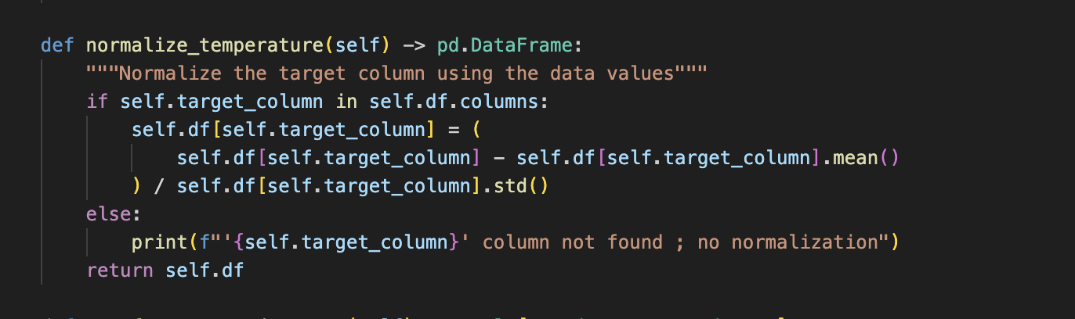
Data Collection and Preprocessing
Implemented normalization techniques - Normalization is the process of transforming data so that it's on a similar scale, this helps models train more effectively and ensures fair comparisons between values.
We implemented normalization using the Z-score method. The formula subtracts the column’s mean from each value and divides it by the standard deviation.
self.df[self.target_column].mean() gets the average.
self.df[self.target_column].std() gets the standard deviation.
The subtraction and division normalize the column.

Slide 10
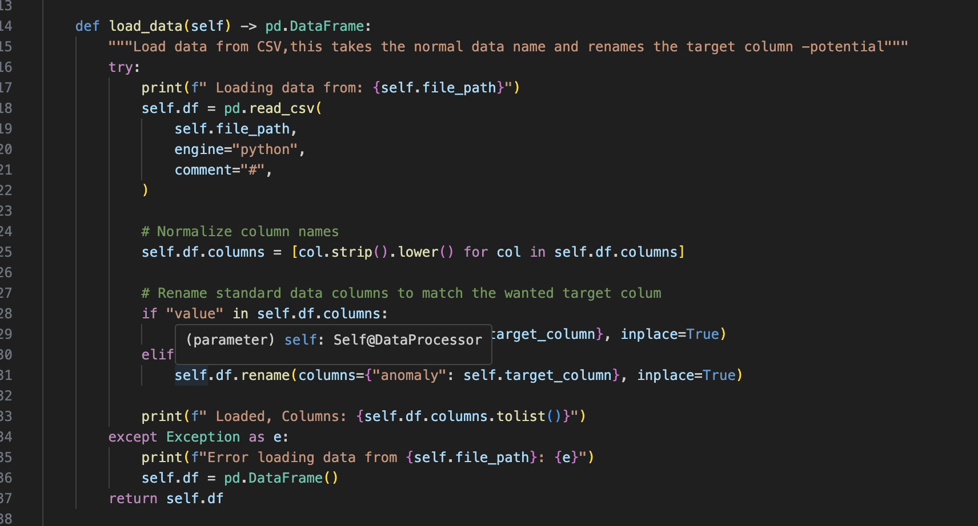
Data Collection and Preprocessing
Data loading is the process of reading external data files (like CSVs) into your program so they can be analyzed or used by algorithms.
pd.read_csv(self.file_path, engine="python", comment="#")
Loads the raw CSV file using the provided file path.
Ignores comment lines (starting with #), which often contain metadata.
self.df.columns = [col.strip().lower() for col in self.df.columns]
Standardizes all column names: removes leading/trailing spaces and converts everything to lowercase (e.g., “ Value ” → “value”).
Automatically detects whether the column is labeled "value" or "anomaly" and renames it to match the desired target (e.g., "precipitation" or "temperature").

Slide 11
Innovative Algorithms
We developed:
Machine learning algorithm to predict future trends.
Clustering algorithm to group similar data
Time series analysis algorithm to detect anomalies
We use custom linear regression in order to predict climate values
We use custom K-means like clustering to group climate data into points
We have an anomaly detection for the average

Slide 12
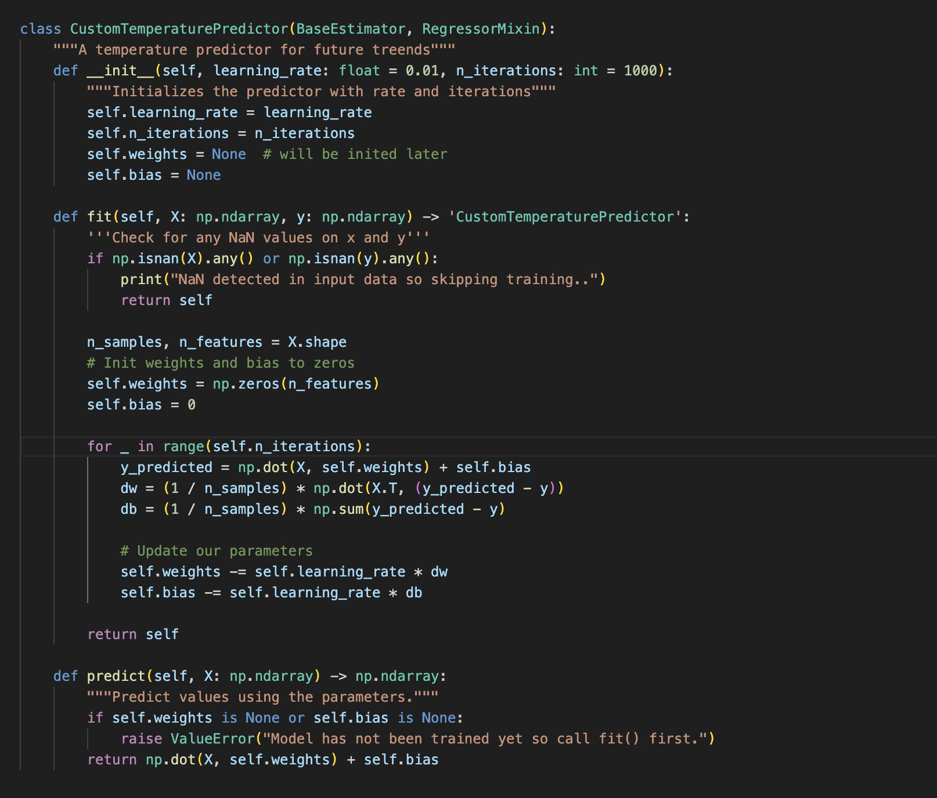
Innovative Algorithms
Custom Linear Regression:
It is coded to predict climate values such as temperature
This is the CustomTemperaturePredictor class that is created in algorithms.py but it is used in CLI, Main, and in the website as well.
What it does:
This is a custom algorithm we built to temperature or precipitation based on historical data.
Gradient Descent:
Runs for n_iterations times:
Predicts values using: y=X⋅weights+bias
Calculates error between predicted and actual values.
Computes gradients and updates to reduce that error.

Slide 13
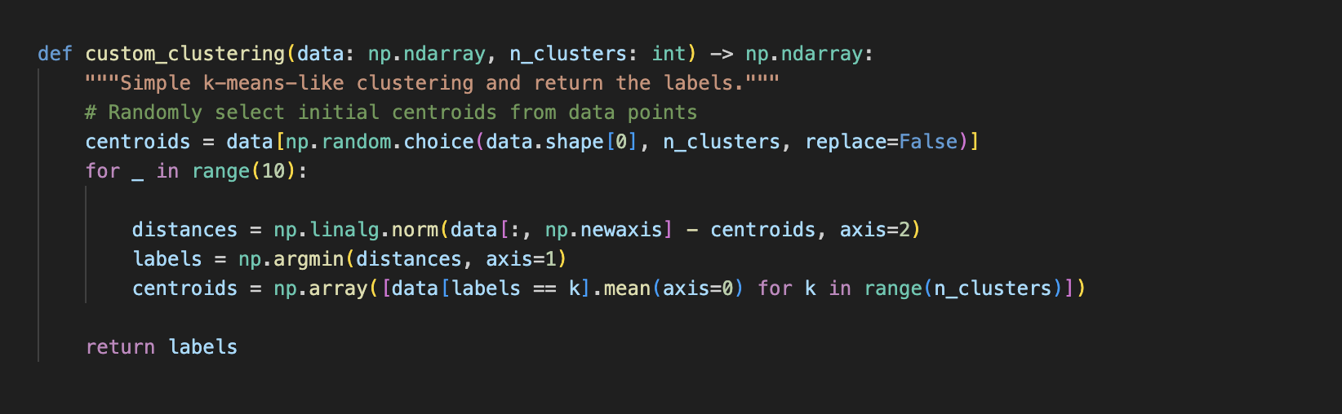
Innovative Algorithms
K-Means like Clustering:
A simplified k-means algorithm to group climate data points into clusters.
This is the custom_clustering that is created in algorithms.py but it is used in CLI, Main, and in the website as well for visualizing grouped climate behavior.
What it does:
This randomly initializes centroids, assigns labels based on closest centroid, then updates it based off of the information gathered.
Picks random points from the dataset to act as initial cluster centers (centroids).
Calculates the distance from every point to every centroid using Euclidean distance.
Helps figure out which centroid each point is closest to.

Slide 14
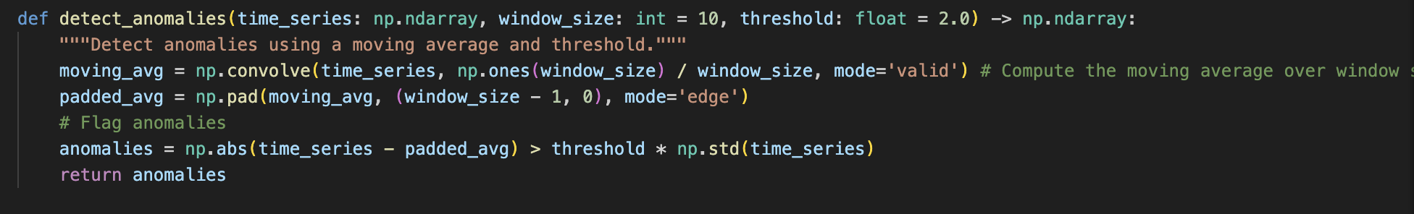
Innovative Algorithms
Anomaly Detection with Moving Average:
This is a method used to identify unusual climate data points.
This is the detect_anomalies function. It compares each value to a rolling average and flags it if the difference is too large using standard deviation. Used in Main, CLI, and website.
What it does:
Establishes baseline of normal in the time series using a rolling average over window_size
Then, it flags data points that deviate too far from the moving average.
The threshold is 2 * standard deviation.
Returns an array like [False, False, True, False...]
Each True means that it point is an anomaly.

Slide 15
Data Visualization
For Data Visualization, we have plots that were made using the Matplotlib for creating informative plots
.
Custom technique for displaying multidimensional climate data
Animated visualization showing climate change over time.
Did the bonus and innovated the data visually.
When it is run, 2 line plots are made, including the actual and the predicted trends over time.
There is a scatter plot that is made that depicts the clustered data
Highlighting anomalies using markers to draw attention to significant things that are different.
Interactive Animations:
This provides an engaging way to interpret complex data, facilitating clearer understanding and effective communication.

Slide 16
Data Visualization
We built our own visualizations using Matplotlib and Seaborn so users can actually see the climate data story and not just the numbers.
We use data visualization to make complex climate data easy to understand, the user is able to see::
How accurate our predictions are
How clusters are formed in the data
Where anomalies/spikes occur
What it does and where it is used:
Prediction VS Actual - Line Plot with Markers
Clustering - Scatter Plot with Color
Anomaly Detection - Line Plot with the OUTLIERS (anomalies)
(Bonus) - Animation - Matplotlib animation
All made on visualizer.py and called on CLI, Main, and even Website

Slide 17
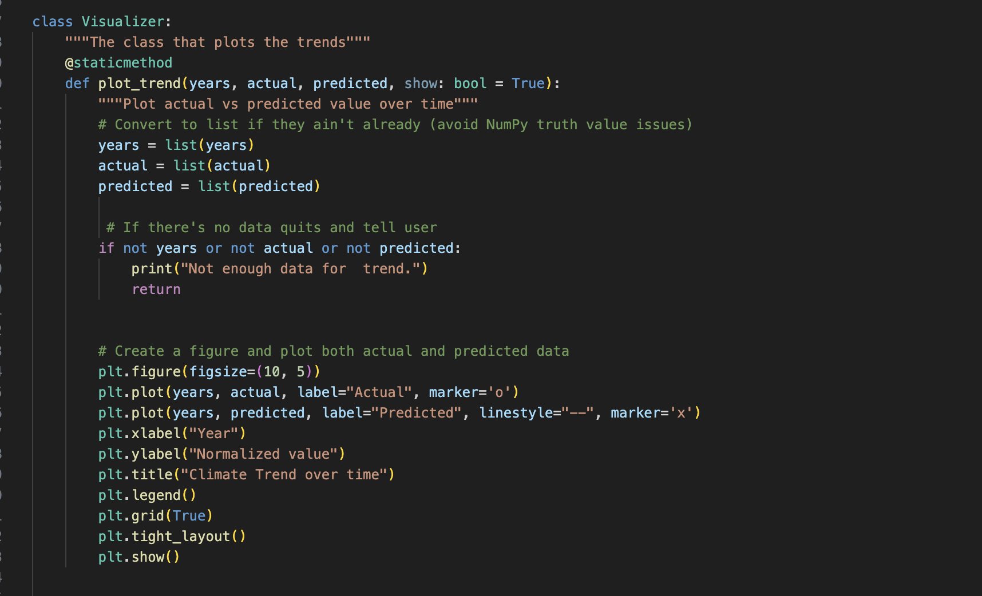
Data Visualization
This function visually compares the actual climate values to the predicted values over time.
Converts input to Python lists
Plots actual values using circles
Plots predicted values using dashed lines and x markers
Adds labels, title, legend, and grid for clarity
Allowing this to be visual helps by showing whether the prediction model is accurate
Makes it easy for non-technical users to understand the model’s performance
Prediction VS Actual - Line Plot with Marker:

Slide 18
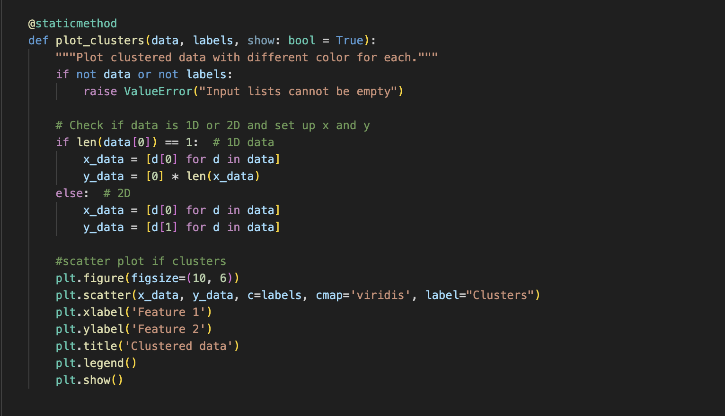
Data Visualization
This function visually displays clusters of climate data, showing how different data points group together based on similarity.
Started off first with error handling
Checks if the data is one-dimensional (e.g., only "year") - IF NOT IT SPLITS IT UP TO X AND Y
plt.scatter(x_data, y_data, c=labels, cmap='viridis')
Plots a scatterplot where each point is color-coded based on its cluster label.
viridis colormap for nice visual distinction.
Clustering - Scatter Plot with Color

Slide 19
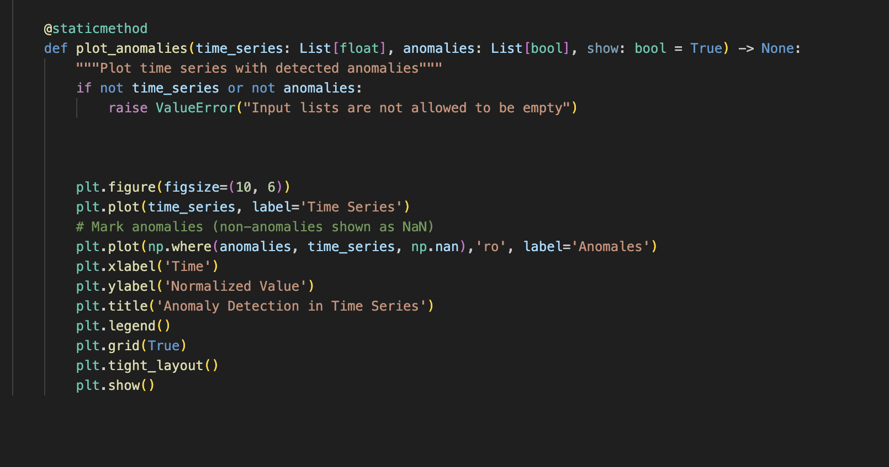
Data Visualization
This function highlights unusual or extreme data points, useful in climate analysis for identifying outliers in trends.
plt.plot(time_series, label='Time Series')
Plots the entire timeline of climate data
plt.plot(np.where(anomalies, time_series, np.nan), 'ro', label='Anomalies')
Uses np.where() to only plot red dots (ro) where anomalies are True.
Non-anomalies are replaced with np.nan which does not plot them
Helps scientists focus attention on specific years or regions that cause problems
Anomaly Detection - Line Plot with the OUTLIERS (anomalies)

Slide 20
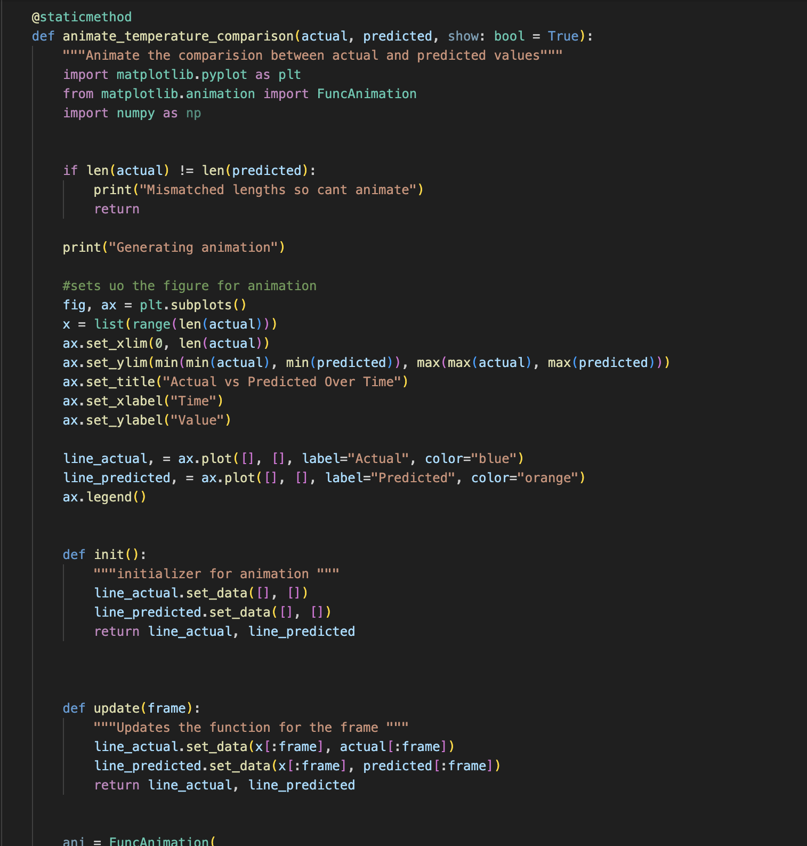
Data Visualization
This function creates an animated line chart showing how actual and predicted climate values evolve over time
Initializes the animation figure and sets the plot boundaries based on data range.
line_actual, = ax.plot([], [], label="Actual", color="blue")
line_predicted, = ax.plot([], [], label="Predicted", color="orange")
Prepares two lines: one for actual values, one for predictions, drawn frame by frame.
ani = FuncAnimation(... interval=100, repeat=False)
Tells Matplotlib to draw 1 new frame every 100ms until all points are plotted.
(Bonus) - Animation - Matplotlib animation

Slide 21
Main
The purpose of main.py is to visualize the project as something the user can easily use to navigate through everything.
files = list_data_files()
Recursively finds all .csv files in the data directory
Displays them with a number so the user can select one.
target_column = auto_detect_target_column(...)
Looks at both the file name and its headers.
Automatically detects whether it should use "temperature", "precipitation", or "anomaly" to analyze.
Preprocess the Data
Cleans the data (removes -9999 and NaNs).
Normalizes values so the models work better.
Extracts features like year and month as inputs.
Runs the prediction
Shows the first 5 predictions vs actual values.
Visualizes it as a line plot + animation.
Notes:
We prompt the user to choose a dataset interactively — for example, precipitation data from Africa or global temperature anomalies.”
It saves time and reduces human error during data input.
If there's missing data or bad formatting, it’ll tell you and stop.
You can see the prediction quality, year over year

Slide 22
Main
5. labels = custom_clustering(X, n_clusters=3) Visualizer.plot_clusters
Groups the data into 3 clusters.
Helps identify regional or seasonal patterns in the data.
Colored Scatter Plot
6. Anomaly Detection:
anomalies = detect_anomalies(y, window_size=3, threshold=1.5)
Visualizer.plot_anomalies
Flags data points that significantly deviate from the moving average
7. print("\n Done, all steps completed.")
Everything is plotted and visualized

Slide 23
CLI - Command Line Interface
The CLI is designed for users who prefer working directly in the terminal.
Load specific climate datasets
Choose a desired action: predict, cluster, or anomalies
Run everything via command-line flags, where there is no user interface
An example command:
python3 -m src.cli --folder precipitation --file precipAsiaNOAA.csv --action predict --target_column precipitation
Our CLI tool lets users skip the interface entirely and work straight from the command line. That’s really useful in scientific workflows or automation scripts, especially if you're analyzing multiple datasets in a loop or doing large-scale modeling.

Slide 24
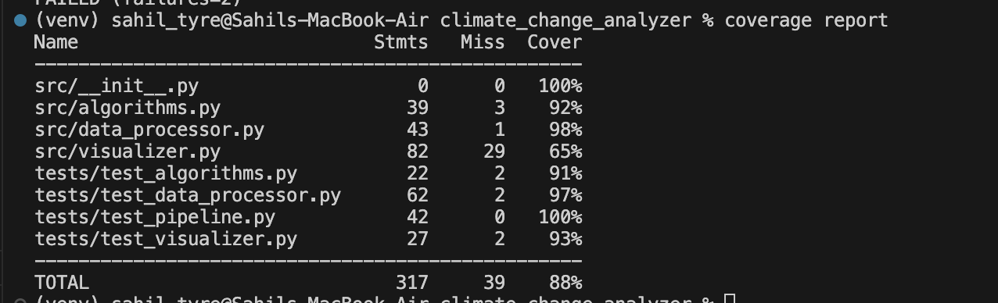
Unit Testing
Automated tests using unittest framework:
We do the unit tests for data processing and each algorithm, and the bonus entire data Pipeline tests to ensure overall functionality.
Demonstrate Unit Testing Live:
In our case, we wrote automated tests to validate:
Data loading and preprocessing
Each algorithm (prediction, clustering, anomaly detection)
Visualizer logic
End-to-end pipeline functionality
We used Python’s built-in unittest module and tracked coverage using the coverage tool.
coverage run -m unittest discover tests
coverage report

Slide 25
Website
As a bonus, we built a Flask-based web application so users can interact with climate data without needing to touch any code.
How it works:
Simple file selection
Dropdown actions
One-click results
Automatically generated graphs
We use python3 -m website.app on the terminal to start the website.
Launches a local web server at http://127.0.0.1:5000
Select a dataset from the dropdown (CSV files from the /data)
Choose an action (predict, clustering, and anomaly detection)
Click Run Analysis to view results

Slide 26
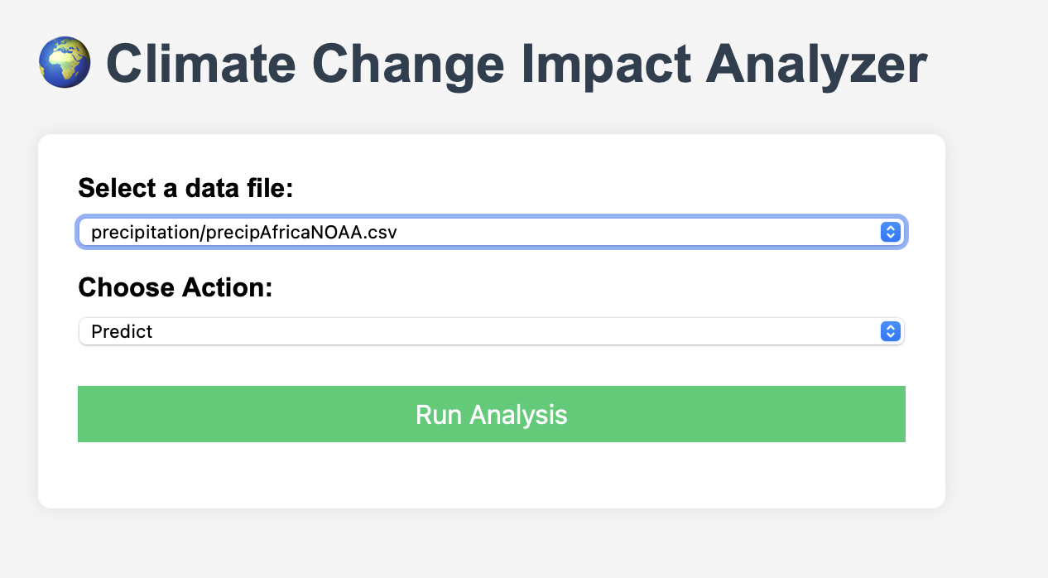
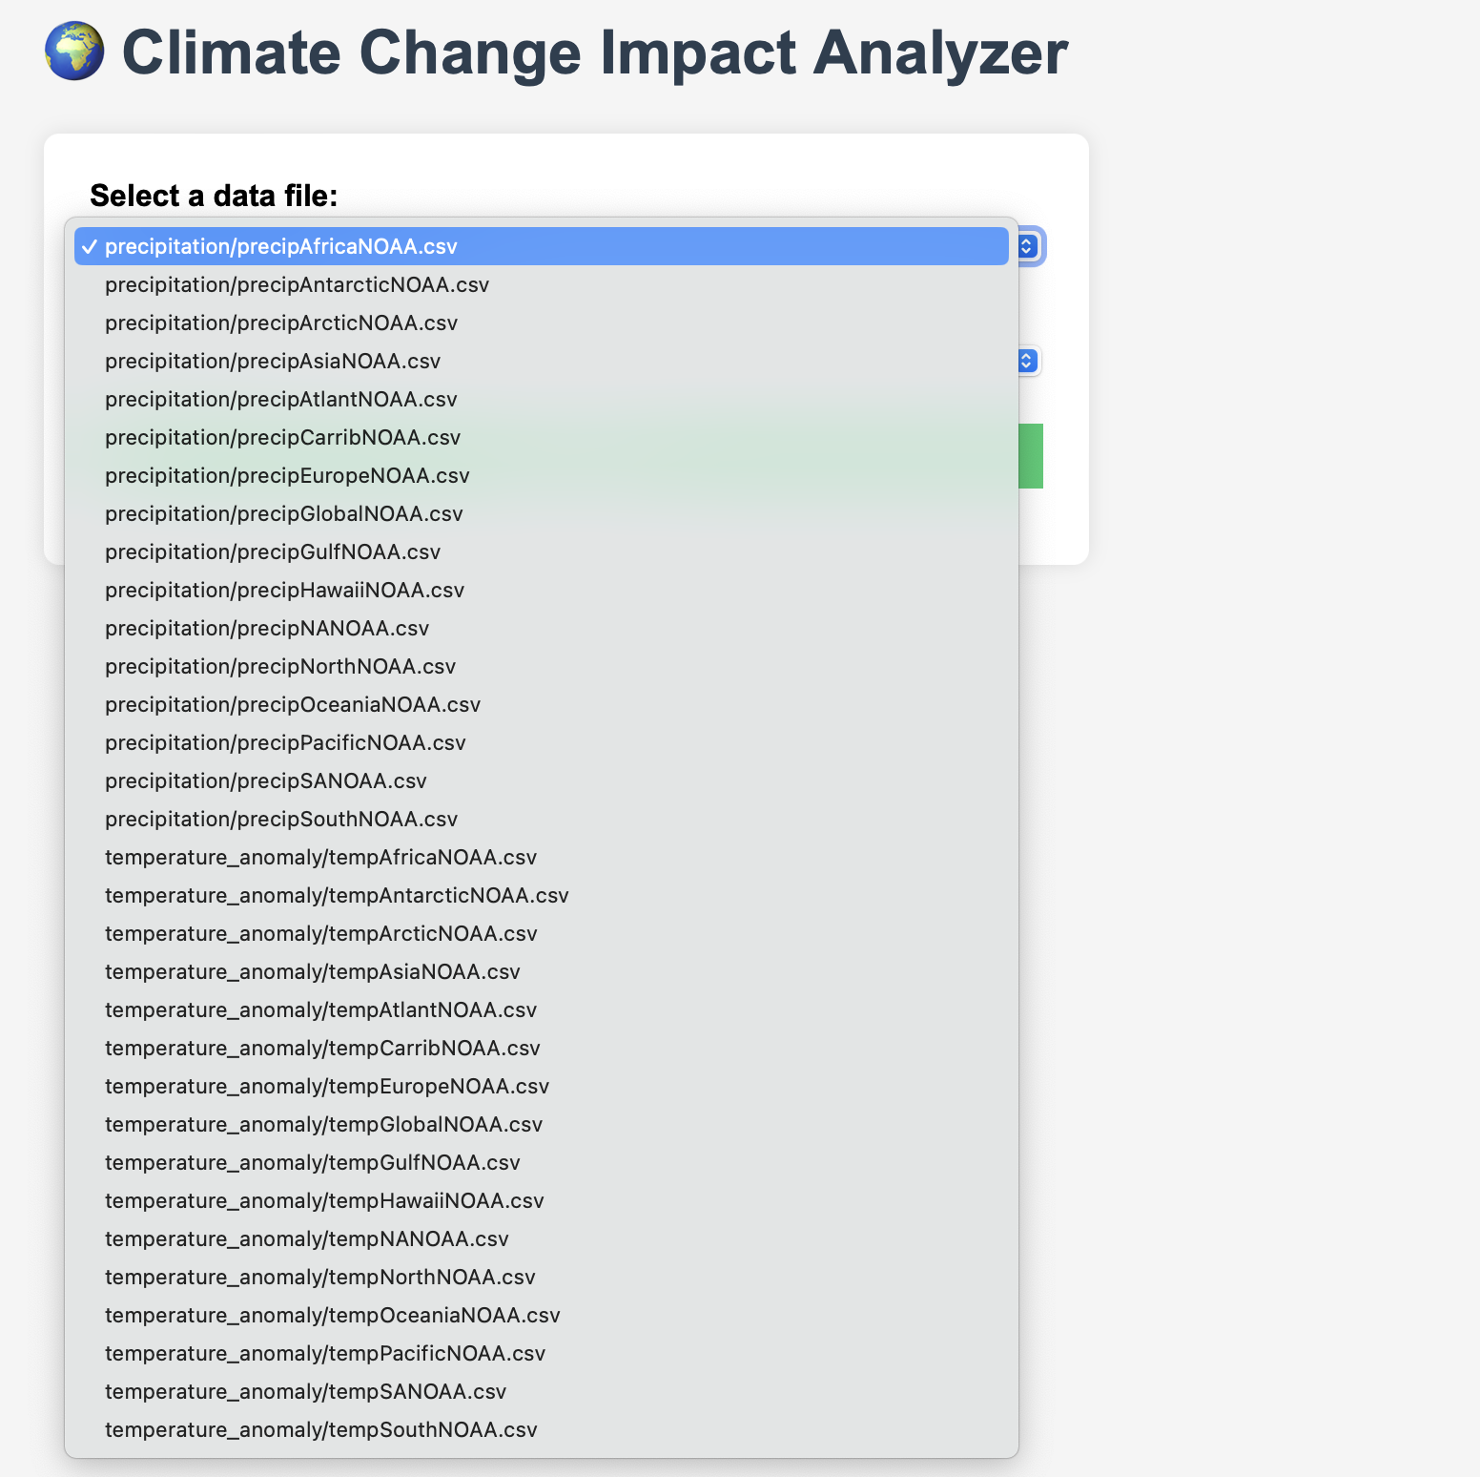
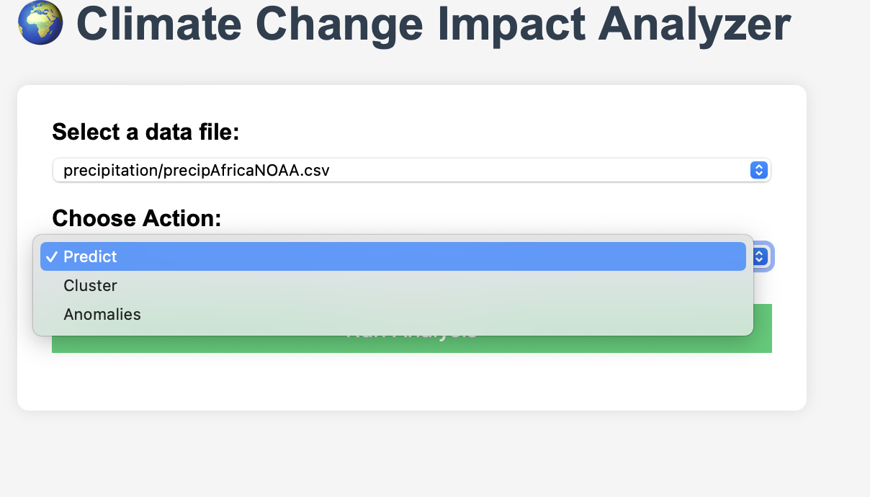
Website
The site uses the same backend logic as the CLI
Loads and cleans the data
Runs the chosen algorithm
Generates and displays plots using matplotlib

Slide 27
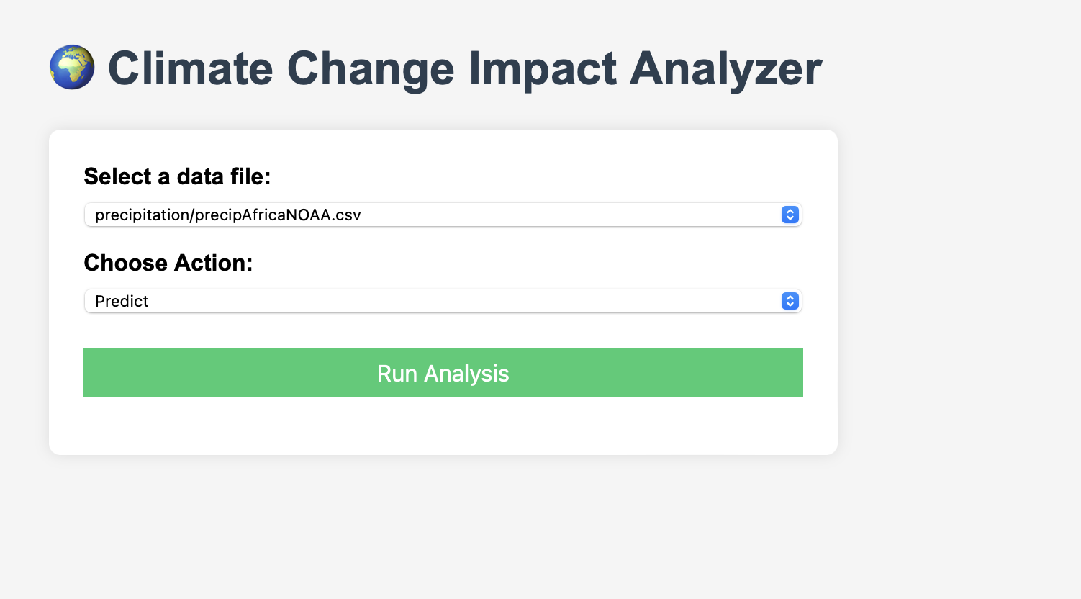
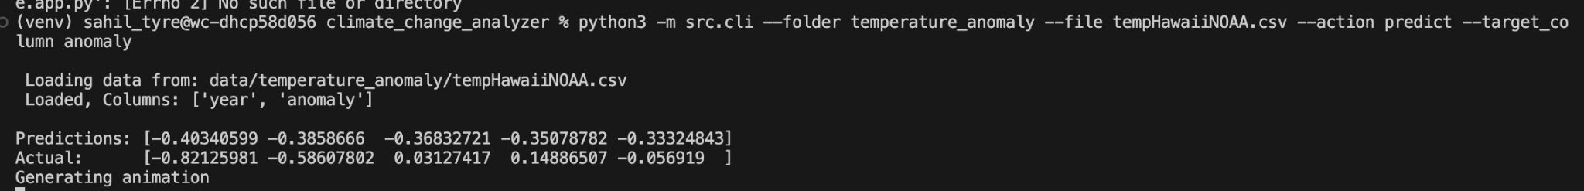
User Interface
The user interface was made in 2 purposes, the CLI and the Website.
CLI
For users who want direct control
Uses flags like --action, --file, --target_column
Output shown in the terminal and charts open automatically
Great for automation, scripting, or batch testing
Web Interface on Flask
User-friendly graphical interface
Select a file
Choose action from a dropdown to predict, cluster, anomaly detection
Generates plots and displays results
http://127.0.0.1:5000

Slide 28
Explain Data
So as we know, All data was collected from NOAA (National Oceanic and Atmospheric Administration)
All the CSV files were organized into folders like:
precipitation/
temperature_anomaly/
Data:
Year column (always present)
Month (sometimes(not in this case, but have it just in case))
Value column (renamed to match: temperature, precipitation, or anomaly)
We normalized all values to standardize across regions
This allowed our real world testing of our prediction and anomaly models, which gave us clear patterns to plot trends and clusters

Slide 29
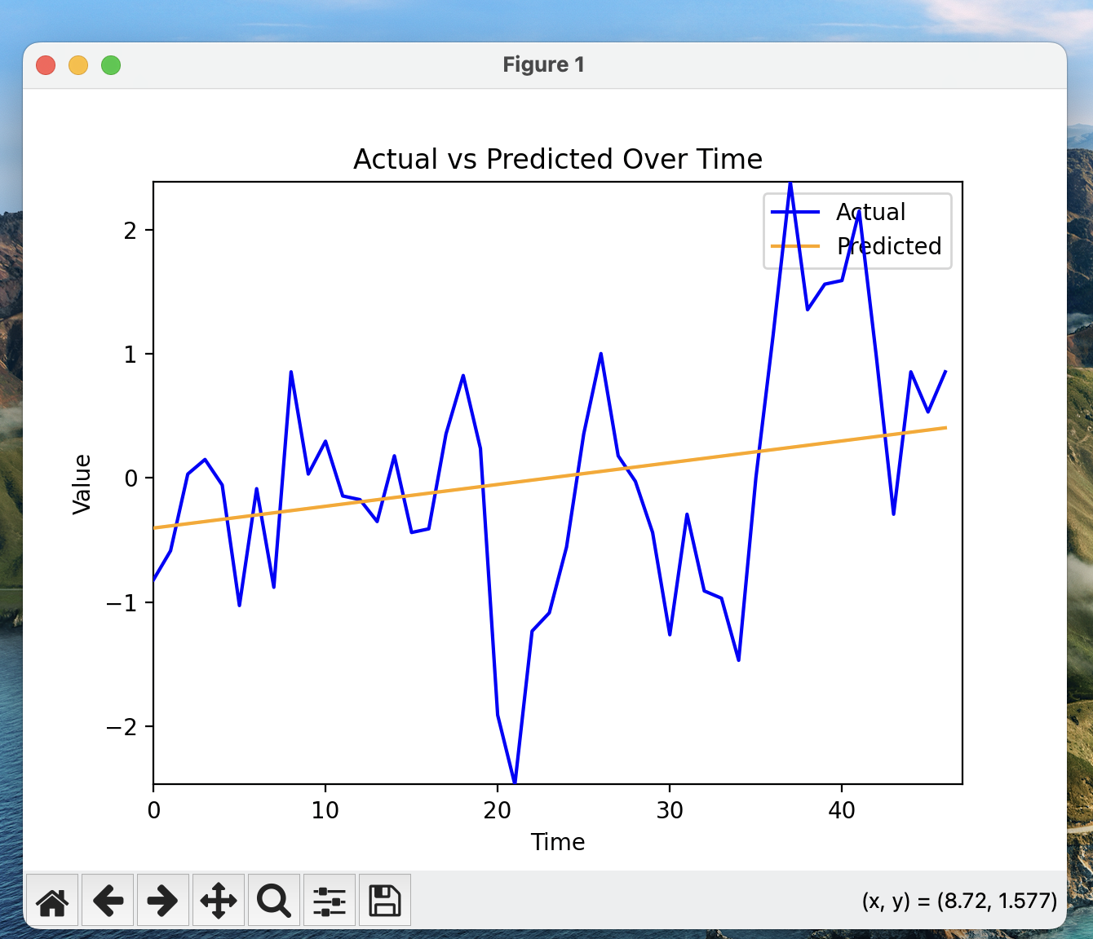
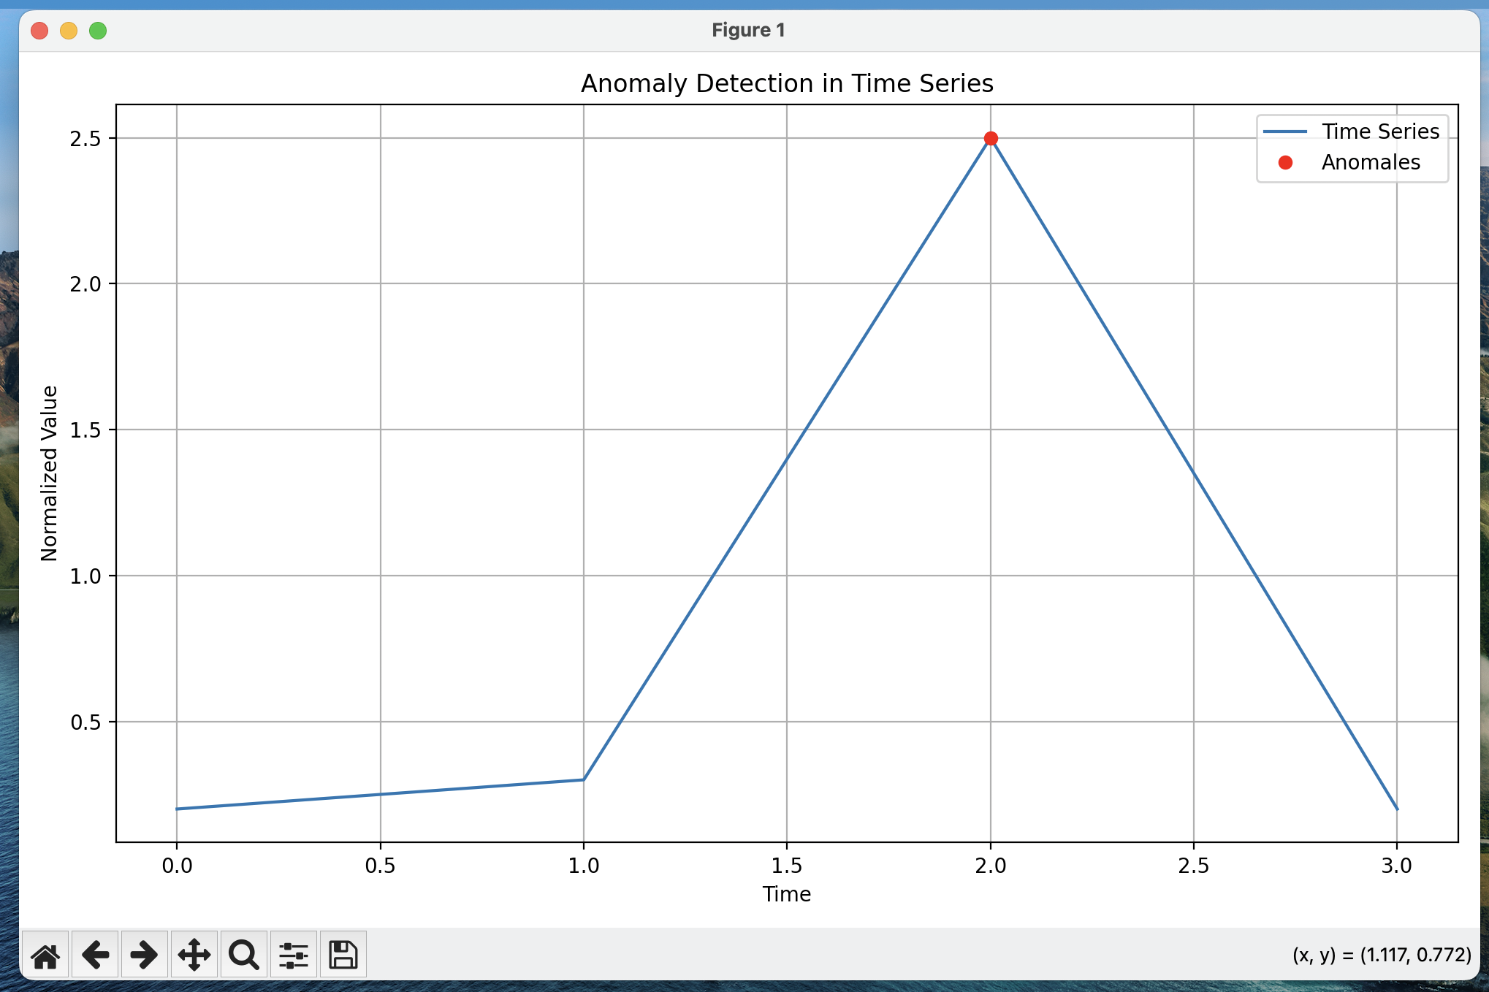
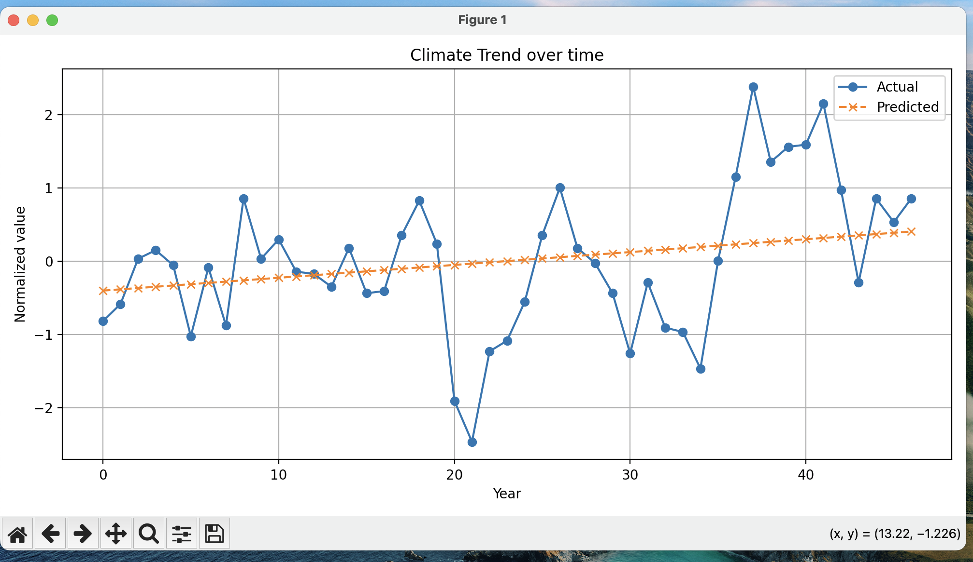
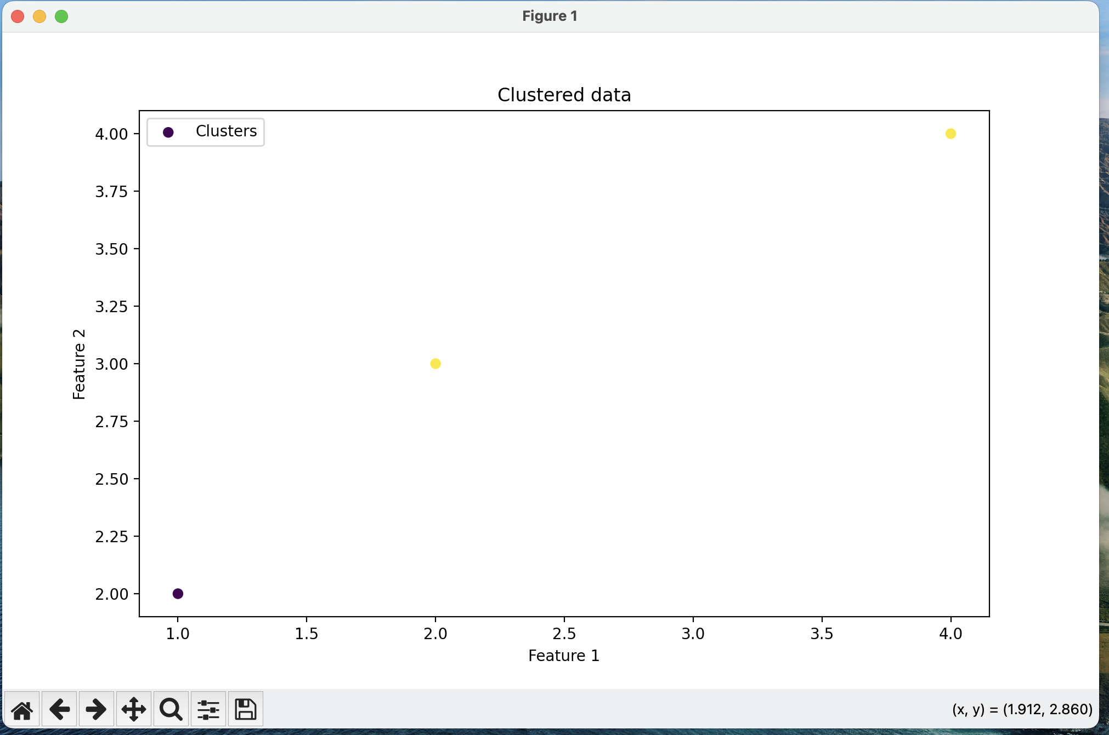
Explain Data
Examples:

Slide 30
Live Demonstration
Now, we will show you the data we came up with and our smooth user interaction, live! !

